Slide 1

Web Services Overview
Web Services for NSI protocol implementation
john@surfnet.nl
imonga@es.net

Slide 2

Advantages of Web Services
Provides interoperability between various software applications running on disparate platforms
Self-describing software modules that encapsulates discrete functionality.
Utilize open standards and protocols
  Protocols and data formats are text-based where possible, making it easy for developers to comprehend.
  Issues such as byte level compatibility, framing, and internationalization are removed so implementers can focus on the protocol contents.
Allows reuse of services and components within an infrastructure
  Discrete interfaces allow for greater reuse than having to participate in a complete protocol implementation.

Slide 3
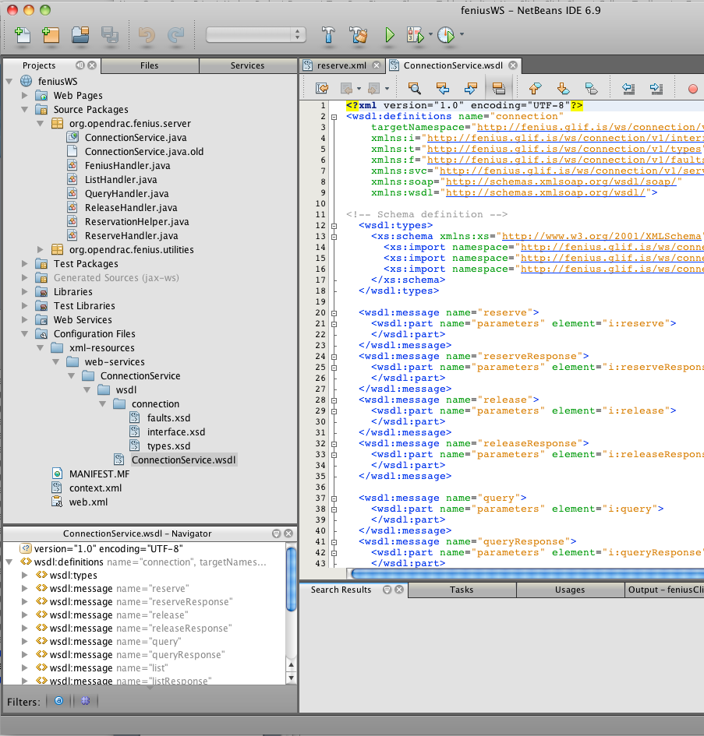
Ease of Development
Web Services development supported in all popular programming languages
  Java has native support while other languages utilized add-on libraries (C/C++, Ruby, .NET, PHP, Perl, etc.).
Eclipse and NetBeans IDE support integrated Web Services development
  Provides rapid prototyping and test environment.
  Dynamic web/application server deployment makes development even easier.
Runtime supported on all major OS versions

Slide 4
Web Service Profile
Web services support both request/response and notification type interaction models.
A standard application profile for Web Services would be deployed using existing standards such as:
  Transport - Hypertext Transfer Protocol (HTTP).
  Encoding - Extensible Markup Language (XML).
  Messaging – SOAP.
  Schema - Web Services Description Language (WSDL).
  Discovery - Universal Description, Discovery, and Integration (UDDI).

Slide 5
Standardized Communication
HTTP currently permits a large number of systems to communicate with one another
  HTTP is a well defined and widely implemented messaging protocol with the key attributes needed out of a base transport protocol.
  Using SOAP over HTTP allows for easier communication through proxies and firewalls than previous remote execution technology.
SOAP (built on XML) is an RPC-style messaging specification
  A platform and language independent protocol for exchanging information in a decentralized and distributed environment.
  SOAP is versatile enough to allow for the use of different transport protocols, with binding to a specific transport a deployment time decision.
  Many implementations utilize HTTP as a transport protocol, but other protocols such as JMS are very popular.
WSDL standardizes the description of Web Services
  Acts as a formal interface contract between providers and requestors within the system.
UDDI standardizes the publishing and finding of Web Services.

Slide 6
Performance
All major vendors have invested considerable resources optimizing their SOAP and XML parsing and formatting engines.
In the majority of implementations the overhead incurred handling XML message parsing is minor when compared to typical service logic implementation.
Bandwidth consumed per message is dependent on the defined application data model
  Fenius reservation requests were, on average, 1.5 KBytes per message.
Standard off the shelf quad core server technology can easily handle thousands of messages a second (of course this is application specific)
  All potential NRM platforms are running on server class machines with high-speed Internet connections and not embedded processors with 56 Kb/s data channels.

Slide 7
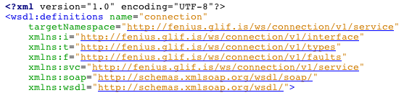
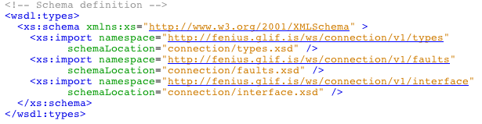
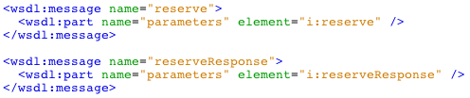
WSDL – The Contract
Namespace definition with
version for this service
Import XML types
for use in message
definition
Define request messages
Response messages
Associated parameter types

Slide 8
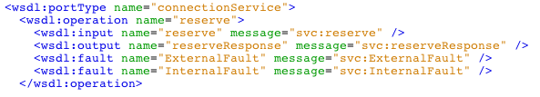
WSDL – The Operations
Define the service port type
Operation name
Input message (request)
Output message (response)
Fault messages (errors)
Define service name
Connection service SOAP endpoint

Slide 9
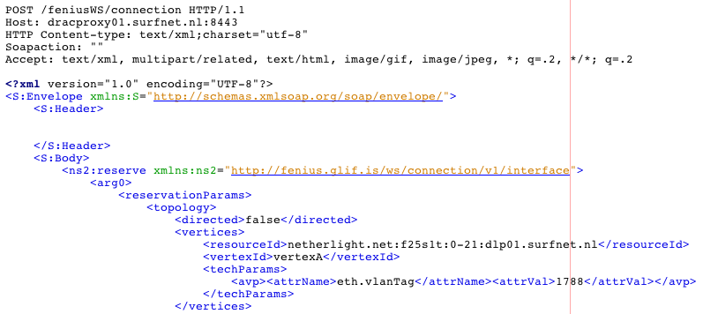

SOAP Message Structure
HTTP Header – All SOAP operations are POST
UTF-8 encoding for internationalization support
SOAP content envelope
…
SOAP header (WS-Addressing, WSS)
SOAP body – contains WSDL defined operations
Schema namespace
Operation
Parameter
…

Slide 10
Request/Response Operations
NSI protocol will support two types of request interactions:
  Request/response mechanism where the response contains the results of the request.
  Request/acknowledgement/response message interaction where the request is first acknowledged, then followed sometime later by a formal response.
Request/response mechanism
  HTTP POST carries the request operation.
  HTTP response to POST carries result of the operation.
  HTTP socket blocks until result it returned.
  Standard design pattern utilizes multiple threads to issue concurrent operations.
Request/acknowledgement/response mechanism
  HTTP POST carries the request operation.
  HTTP response to POST carries the acknowledgement of the request with the appropriate correlation Id (messTransID or specific operation TransID).
  Provider NSA will POST operation result to the Requestor NSA using their notification SOAP endpoint.

Slide 11
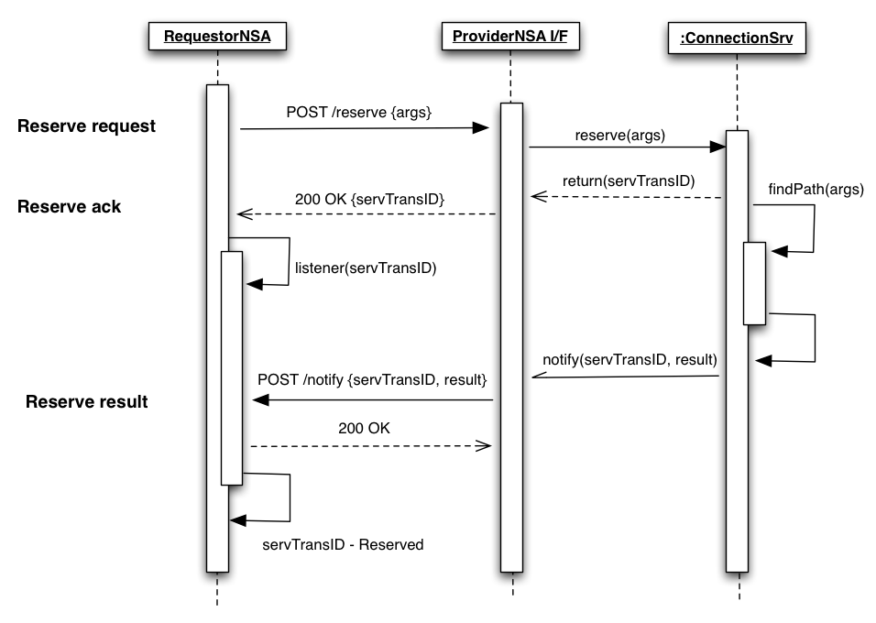
Asynchronous Messaging

Slide 12
Notifications
There are two primary notification patterns used for SOAP
  Notification “push” interface that delivers events asynchronously to a client’s registered SOAP endpoint.
  Notification “pull” interface that will queue notifications for the client to poll via the publisher’s SOAP endpoint.
There are two options for notification service definitions
  Application specific notifications defined through application specific schema allowing for custom notification solutions
    3GPP Parlay X standards follow this model having integrated notifications into their messaging definitions.
  Standards based notification frameworks (WS-BaseNotification) following the publish/subscribe pattern with topics
    Subscribe, Renew, Unsubscribe, PauseSubscription, ResumeSubscription, Notify, GetCurrentMessage, GetMessages.

